Slide 1
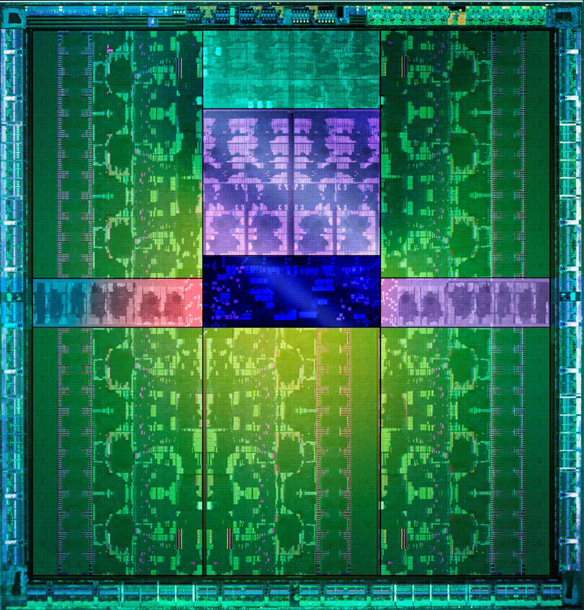
GPU programming
Dr. Bernhard Kainz

Slide 2
Overview
About myself
Motivation
GPU hardware and system architecture
GPU programming languages
GPU programming paradigms
Example program
Memory model
Tiling
Reduction
State-of-the-art applications
Last week
This week

Slide 3
Distinguishing between threads
blockId and threadId
0,0
1,0
0,0
1,0
2,0
3,0
4,0
5,0
6,0
7,0
0,0
1,0
2,0
3,0
4,0
5,0
6,0
7,0
0,0
1,0
2,0
3,0
0,0
1,0
2,0
3,0
0,0
1,0
2,0
3,0
0,0
1,0
2,0
3,0
0,0
1,0
2,0
3,0
1,0
4,0
5,0
6,0
7,0
0,0
0,0
1,0
0,0
1,0
0,0
1,0
3,0
0,0
1,0
0,0
1,0
0,0
1,0
2,0
0,0
1,0
0,0
1,0
0,1
1,1
0,0
1,0
2,0
3,0
4,0
5,0
6,0
7,0
0,0
1,0
2,0
3,0
4,0
5,0
6,0
7,0
0,1
1,1
2,1
3,1
0,1
1,1
2,1
3,1
0,1
1,1
2,1
3,1
0,1
1,1
2,1
3,1
0,1
1,1
0,1
1,1
0,1
1,1
0,1
1,1
0,1
1,1
0,1
1,1
0,1
1,1
0,1
1,1
0,2
1,2
0,0
1,0
2,0
3,0
4,0
5,0
6,0
7,0
0,0
1,0
2,0
3,0
4,0
5,0
6,0
7,0
0,2
1,2
2,2
3,2
0,2
1,2
2,2
3,2
0,2
1,2
2,2
3,2
0,2
1,2
2,2
3,2
0,1
1,1
2,1
3,1
4,1
5,1
6,1
7,1
0,0
1,0
0,0
1,0
0,0
1,0
0,0
1,0
0,0
1,0
0,0
1,0
0,0
1,0
0,0
1,0
0,3
1,3
2,3
3,3
0,3
1,3
2,3
3,3
1,3
0,0
1,0
2,0
3,0
4,0
5,0
6,0
7,0
0,3
1,3
2,3
3,3
0,0
1,0
2,0
3,0
4,0
5,0
6,0
7,0
0,3
0,1
1,1
0,3
1,3
2,3
3,3
0,1
1,1
0,1
1,1
0,1
1,1
0,1
1,1
0,1
1,1
0,1
1,1
0,1
1,1
0,0
1,0
2,0
3,0
4,0
5,0
6,0
7,0
0,0
1,0
2,0
3,0
4,0
5,0
6,0
7,0
0,0
1,0
2,0
3,0
0,4
1,4
0,0
1,0
2,0
3,0
0,0
1,0
2,0
3,0
0,0
1,0
2,0
3,0
0,2
1,2
2,2
3,2
6,2
7,2
1,1
4,2
5,2
0,0
1,0
0,1
2,1
3,1
0,0
1,0
0,0
1,0
0,0
1,0
0,0
1,0
0,0
1,0
0,0
1,0
0,0
1,0
0,5
1,5
0,0
1,0
2,0
3,0
0,1
1,1
2,1
3,1
0,1
1,1
2,1
3,1
4,0
5,0
6,0
7,0
0,0
1,0
2,0
3,0
4,0
5,0
6,0
7,0
0,1
1,1
2,1
3,1
0,1
1,1
2,1
3,1
0,1
1,1
0,1
1,1
0,1
1,1
0,1
1,1
0,1
1,1
0,1
1,1
0,1
1,1
0,1
1,1
0,2
1,2
2,2
3,2
0,2
1,2
2,2
3,2
0,2
1,2
2,2
3,2
0,2
1,2
2,2
3,2
0,6
1,6
0,0
1,0
1,3
2,3
3,3
0,3
2,0
3,0
4,0
5,0
6,0
7,0
0,0
1,0
2,0
3,0
4,0
5,0
6,0
7,0
4,3
5,3
6,3
7,3
0,0
1,0
0,0
1,0
0,0
1,0
0,0
1,0
0,0
1,0
0,0
1,0
0,0
1,0
0,0
1,0
0,3
1,3
2,3
3,3
0,3
1,3
2,3
3,3
0,3
1,3
2,3
3,3
0,3
1,3
2,3
3,3
0,0
1,0
2,0
3,0
4,0
5,0
6,0
7,0
0,0
1,0
2,0
3,0
4,0
5,0
6,0
7,0
0,7
1,7
0,1
1,1
0,1
1,1
0,1
1,1
0,1
1,1
0,1
1,1
0,1
1,1
0,1
1,1
0,1
1,1
0,0
1,0
2,0
3,0
0,0
1,0
2,0
3,0
0,0
1,0
2,0
3,0
0,4
5,4
6,4
7,4
0,0
1,0
1,4
2,4
3,4
4,4
0,0
1,0
2,0
3,0
2,0
3,0
4,0
5,0
6,0
7,0
0,0
1,0
2,0
3,0
4,0
5,0
6,0
7,0
0,8
1,8
0,2
1,2
2,2
3,2
0,0
1,0
0,0
1,0
0,0
1,0
0,0
1,0
0,0
1,0
0,0
1,0
0,0
1,0
0,0
1,0
0,1
1,1
2,1
3,1
0,1
1,1
2,1
3,1
0,1
1,1
2,1
3,1
0,1
1,1
2,1
3,1
0,9
1,9
0,0
1,0
2,0
3,0
4,0
5,0
6,0
7,0
0,0
1,0
2,0
3,0
4,0
5,0
6,0
7,0
0,1
1,1
0,1
1,1
0,1
1,1
0,1
1,1
0,1
1,1
0,1
1,1
0,1
1,1
0,1
1,1
0,2
1,2
2,2
3,2
0,2
1,2
2,2
3,2
0,2
1,2
2,2
3,2
0,2
1,2
2,2
3,2
0,5
1,5
2,5
3,5
0,10
1,10
4,5
5,5
6,5
7,5
0,0
1,0
2,0
3,0
0,0
1,0
0,0
1,0
0,0
1,0
0,0
1,0
0,0
1,0
0,0
1,0
4,0
5,0
6,0
7,0
0,0
1,0
2,0
3,0
4,0
5,0
6,0
7,0
0,0
1,0
0,0
1,0
0,3
1,3
2,3
3,3
0,3
1,3
2,3
3,3
0,3
1,3
2,3
3,3
0,3
1,3
2,3
3,3
0,0
1,0
2,0
3,0
0,1
1,1
0,1
1,1
0,1
1,1
0,1
1,1
0,1
1,1
0,1
1,1
4,0
5,0
6,0
7,0
0,0
1,0
2,0
3,0
4,0
5,0
6,0
7,0
0,1
1,1
0,1
1,1
0,11
1,11
Notes:
Threads within same block can communicate efficently

Slide 4
2D Kernel example
using threadIdx and blockIdx execution paths are chosen
with blockDim and gridDim number of threads can be determined
__global__ void myfunction(float *input, float* output)
{
uint bid = blockIdx.x + blockIdx.y * gridDim.x;
uint tid = bId * (blockDim.x * blockDim.y) +
(threadIdx.y * blockDim.x) + threadIdx.x;
output[tid] = input[tid];
}
dim3 blockSize(32,32,1);
dim3 gridSize((iSpaceX + blockSize.x - 1)/blockSize.x,
(iSpaceY + blockSize.y - 1)/blockSize.y), 1)
myfunction<<<gridSize, blockSize>>>(input, output);

Slide 5
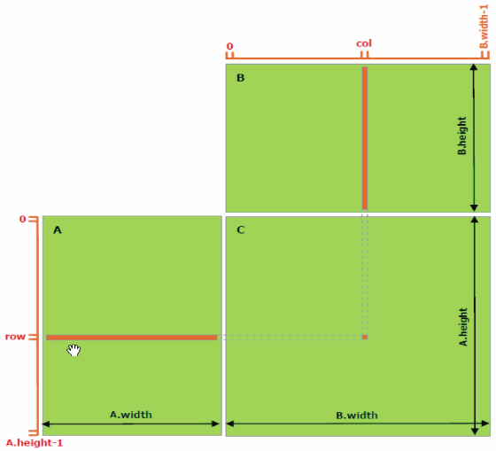
Matrix Multiplication Example
$$C_{ij}= \sum_{k=1}^{m}{A_{ik}B_{kj}}$$

Slide 6
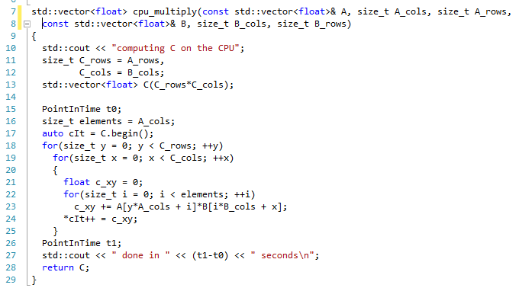
Matrix Multiplication Example
Loop-based parallelism

Slide 7
Matrix Multiplication Example

Slide 8
Matrix Multiplication Example
float* A = new float[A_rows*A_cols];
float* B = new float[B_rows*B_cols];
float* C = new float[B_cols*A_rows];
//some matrix initialization
float* d_A, d_B, d_C;
cudaMalloc((void**)&d_A, A_rows*A_cols*sizeof(float));
cudaMalloc((void**)&d_B, B_rows*B_cols*sizeof(float));
cudaMalloc((void**)&d_C, B_cols*A_rows*sizeof(float));
cudaMemcpy(d_A, A, cudaMemcpyHostToDevice);
cudaMemcpy(d_B, B, cudaMemcpyHostToDevice);
cudaMemcpy(C, d_C, cudaMemcpyDeviceToHost);
//free stuff

Slide 9
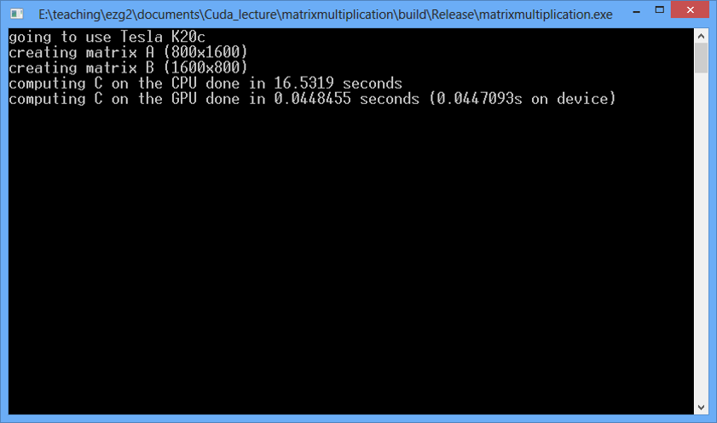
Matrix Multiplication Example

Slide 10
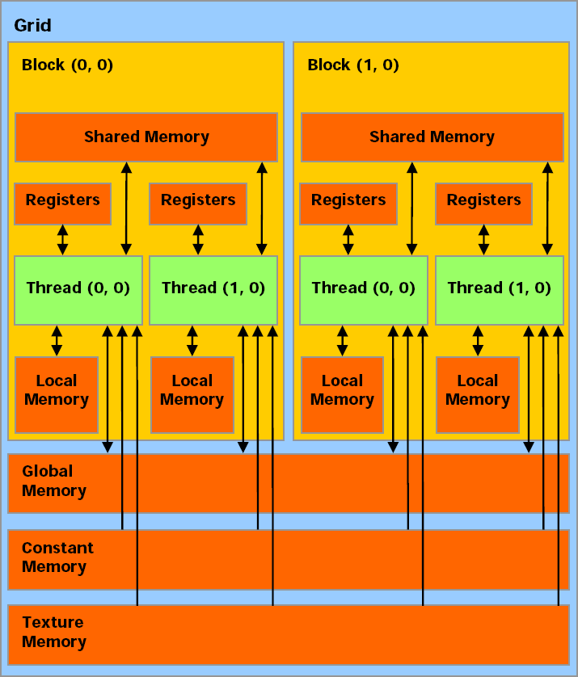
Memory Model
CPU
Host Memory

Slide 11
Matrix Multiplication Example
A lot of memory access with little computations only
Memory access is all going to slow global device memory
In a block the same memory is needed by multiple threads
→use shared memory to load one tile of data, consume the data together, advance to next block

Slide 12
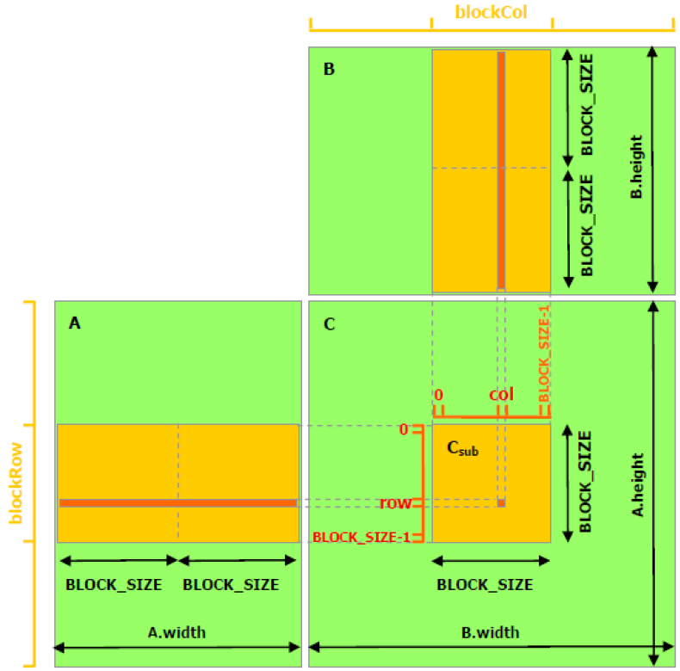
Matrix Multiplication Example

Slide 13
Matrix Multiplication Example
Data loaded
BLOCKS_SIZE times!
Load tiles, work on tiles,
load next tiles …

Slide 14
Matrix Multiplication Example
Blocksize: TILE_WIDTH x TILE_WIDTH

Slide 15
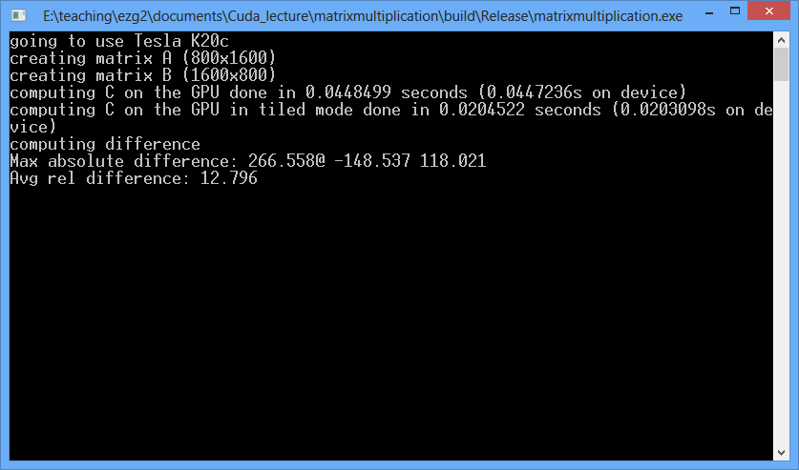
Matrix multiplication problems

Slide 16
Matrix multiplication problems
Read from another thread before loaded!!

Slide 17
Matrix multiplication problems

Slide 18
Matrix multiplication problems

Slide 19
Matrix multiplication problems

Slide 20
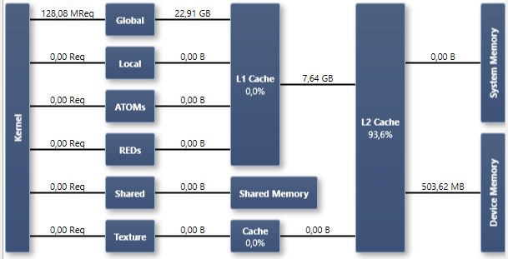
Memory statistics: non-tiled

Slide 21
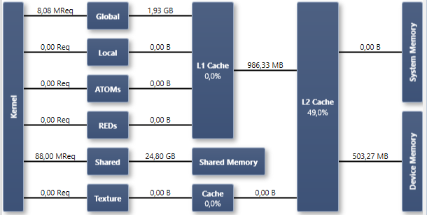
Memory statistics: tiled

Slide 22
Parallel Reduction
Illustrations by Mark Harris, Nvidia

Slide 23
Parallel Reduction
Common and important data parallel primitive
Easy to implement in CUDA
Harder to get it right
Serves as a great optimization example
Several different versions possible
Demonstrates several important optimization strategies

Slide 24
Parallel Reduction
Tree-based approach used within each thread block
Need to be able to use multiple thread blocks
To process very large arrays
To keep all multiprocessors on the GPU busy
Each thread block reduces a portion of the array
Communicate partial results between thread blocks?

Slide 25
Parallel Reduction
If we could synchronize across all thread blocks, could easily reduce very large arrays, right?
Global sync after each block produces its result
Once all blocks reach sync, continue recursively
But CUDA has no global synchronization. Why?
Expensive to build in hardware for GPUs with high processor count
Would force programmer to run fewer blocks (no more than # multiprocessors * # resident blocks / multiprocessor) to avoid deadlock, which may reduce overall efficiency
Solution: decompose into multiple kernels
Kernel launch serves as a global synchronization point
Kernel launch has negligible HW overhead, low SW overhead

Slide 26
Parallel Reduction
Avoid global sync by decomposing computation into multiple kernel invocations
In the case of reductions, code for all levels is the same
Recursive kernel invocation

Slide 27
Parallel Reduction
Your turn:
Take two memory elements. Add them together, put one in your pocket.
Take the memory element from your neighbour on your left on my command.
Add the two numbers (1) together and write down result in “Step 1”, put the other memory element in your pocket.
Take the memory element from your the next neighbour on your left who has still a memory element.
Add the two numbers together and write down result in “Step 2”, other one in pocket.
Continue on my command until only he most right column has memory elements.
Pass down the column to the next neighbour with a memory element and add numbers together, write in next empty Step “field”, put other element away.
Continue until only one thread (student) is left = result.

Slide 28
Parallel Reduction – Interleaved Addressing

Slide 29
Parallel Reduction
We should strive to reach GPU peak performance
Choose the right metric:
GFLOP/s: for compute-bound kernels
Bandwidth: for memory-bound kernels
Reductions have very low arithmetic intensity
1 flop per element loaded (bandwidth-optimal)
Therefore we should strive for peak bandwidth
Will use G80 for this example
384-bit memory interface, 900 MHz DDR
384 * 1800 / 8 = 86.4 GB/s

Slide 30
Parallel Reduction
Many optimizations possible, the one we did is the least efficient
Very good discussion: https://people.maths.ox.ac.uk/gilesm/cuda/prac4/reduction.pdf
On G80
architecture

Slide 31
Examples and applications

Slide 32
Real-time optical flow
https://www.youtube.com/watch?v=1D93RmW_eN4

Slide 33
Real time medical image analysis and visualization
https://www.youtube.com/watch?v=mHO6gCm9EP4

Slide 34
KinectFusion
Developed at DOC@Imperial
https://www.youtube.com/watch?v=quGhaggn3cQ

Slide 35
KinectFusion
https://www.youtube.com/watch?v=fE_FnG4RAm8

Slide 36
Medical Imaging EPSRC Centre for Doctoral Training
15 fully-funded PhD places for graduates in physics, chemistry, biology, engineering and mathematics
Integrated cross-institutional training programme (MRes + 3-year PhD)
Research projects available for:
Image acquisition & reconstruction
Imaging chemistry & biology
Image computing & computational modelling
Apply by 4 January 2016:
www.imagingcdt.com
Contact: imaging-cdt@kcl.ac.uk

Slide 37
GPU programming
Dr. Bernhard Kainz

