Slide 1
GPU programming
Dr. Bernhard Kainz

Slide 2
Overview
About myself
Motivation
GPU hardware and system architecture
GPU programming languages
  GPU programming paradigms
Pitfalls and best practice
Reduction and tiling examples
State-of-the-art applications
This week
Next week

Slide 3

About myself
Born, raised, and educated in Austria
PhD in interactive medical image analysis and visualisation
Marie-Curie Fellow, Imperial College London, UK
Senior research fellow King‘s College London
Lecturer in high-performance medical image analysis at DOC
> 10 years GPU programming experience

Slide 4
History

Slide 5
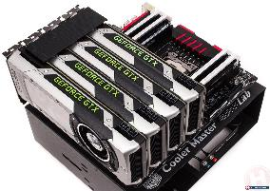
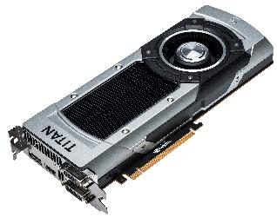
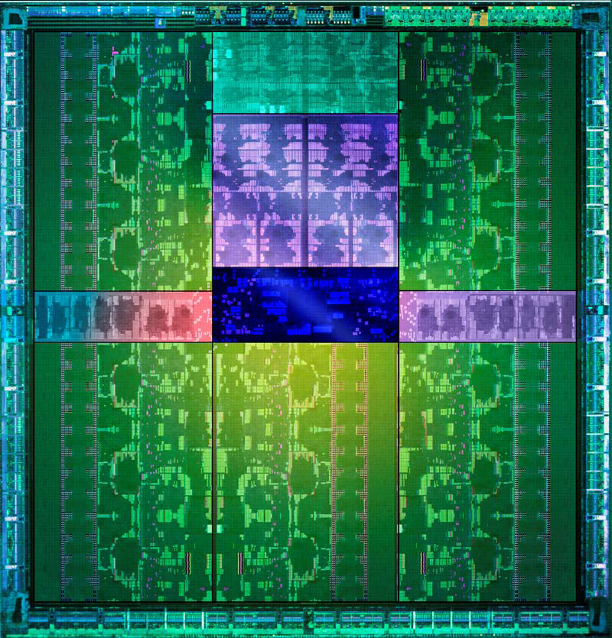
GPUs
GPU = graphics processing unit
GPGPU = General Purpose Computation on Graphics Processing Units
CUDA = Compute Unified Device Architecture
OpenCL = Open Computing Language
Images: www.geforce.co.uk

Slide 6





History
First dedicated GPUs
Brook
OpenCL
you
Other (graphics related) developments
1998
2004
2007
2008
now
Modern interfaces to CUDA and OpenCL (python, Matlab, etc.)
programmable shader
CUDA

Slide 7




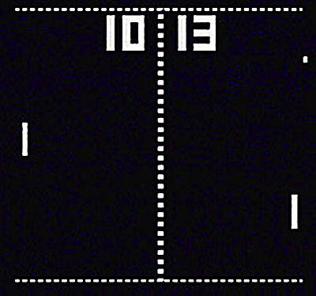
Why GPUs became popular
http://www.computerhistory.org/timeline/graphics-games/
Notes:
People wanted to have more realistic but still interactive compter games

Slide 8
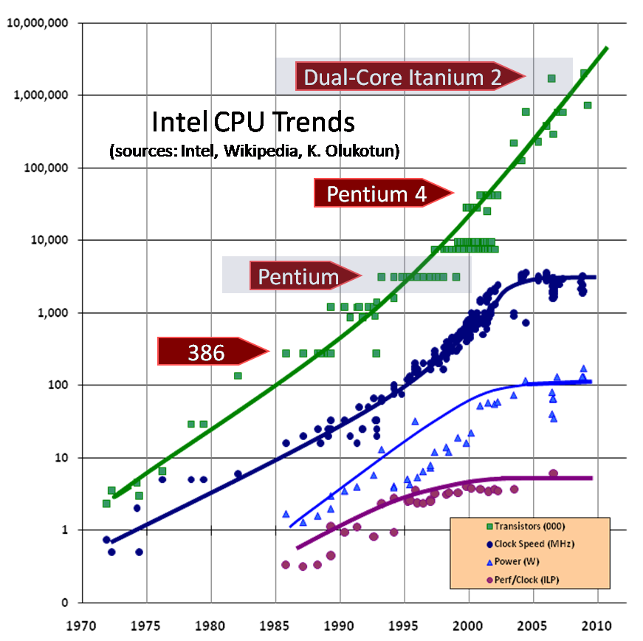
Why GPUs became popular for computing
Sandy Bridge
Haswell
© HerbSutter
„The free lunch is over“
Notes:
At the same time we computer scientists ran into another problem

Slide 9
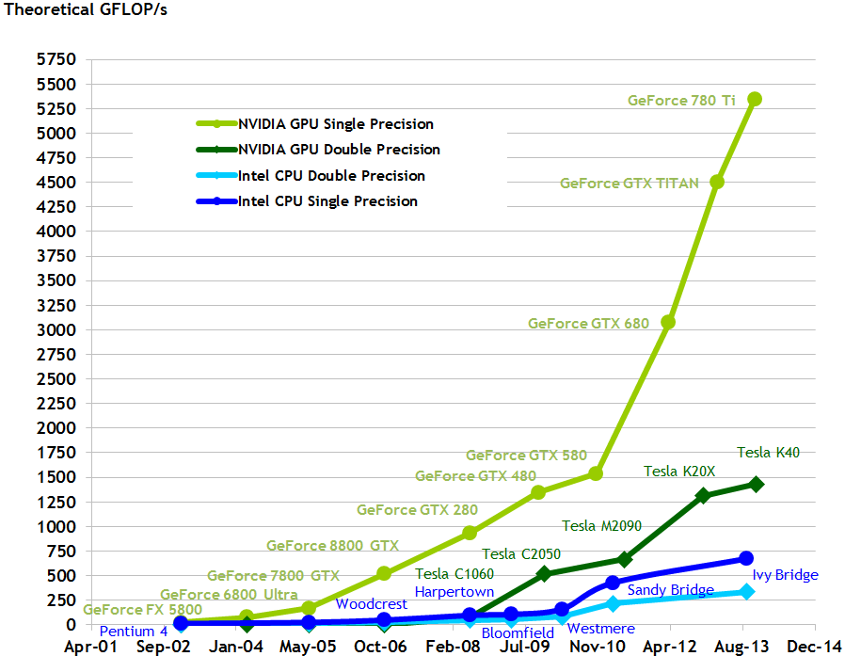
cuda-c-programming-guide

Slide 10
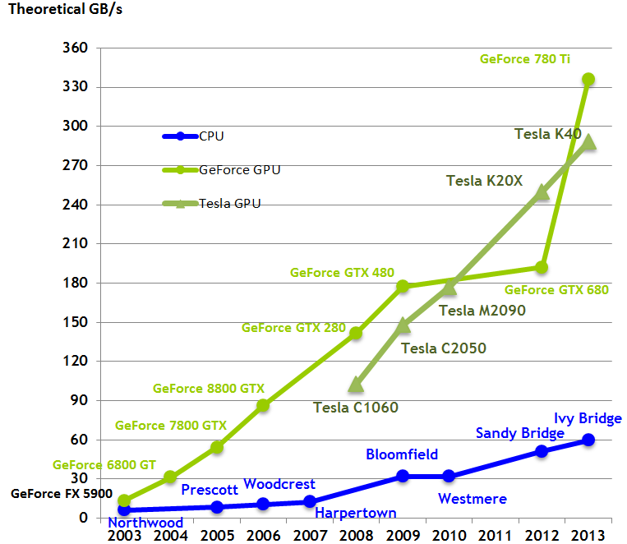
cuda-c-programming-guide

Slide 11
Motivation

Slide 12
parallelisation
Thread 0
1
+
1
=
2
for (int i = 0; i < N; ++i)
c[i] = a[i] + b[i];
…
…
…
…
…
…

Slide 13
parallelisation
Thread 0
1
+
1
=
2
for (int i = 0; i < N/2; ++i)
c[i] = a[i] + b[i];
…
…
…
Thread 1
for (int i = N/2; i < N; ++i)
c[i] = a[i] + b[i];
…
…
…

Slide 14
parallelisation
Thread 0
1
+
1
=
2
for (int i = 0; i < N/3; ++i)
c[i] = a[i] + b[i];
…
…
…
Thread 1
for (int i = N/3; i < 2*N/3; ++i)
c[i] = a[i] + b[i];
…
…
…
Thread 2
for (int i = 2*N/3; i < N; ++i)
c[i] = a[i] + b[i];

Slide 15
multi-core CPU
Control
ALU
ALU
ALU
ALU
Cache
DRAM

Slide 16
parallelisation
1
+
1
=
2
c[0] = a[0] + b[0];
…
…
…
c[1] = a[1] + b[1];
c[2] = a[2] + b[2];
c[3] = a[3] + b[3];
c[4] = a[4] + b[4];
c[5] = a[5] + b[5];
…
…
…
c[N-1] = a[N-1] + b[N-1];
c[N] = a[N] + b[N];
Notes:
If we would have as many threads as processes then we could do this straight forwardly

Slide 17
multi-core GPU
DRAM

Slide 18
Terminology

Slide 19
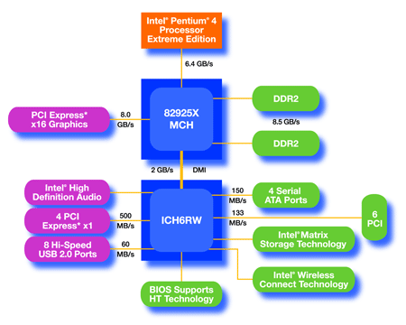
Host vs. device
CPU
(host)
GPU w/
local DRAM
(device)
Notes:
a GPU is not a computer on it’s own. it needs a host system

Slide 20
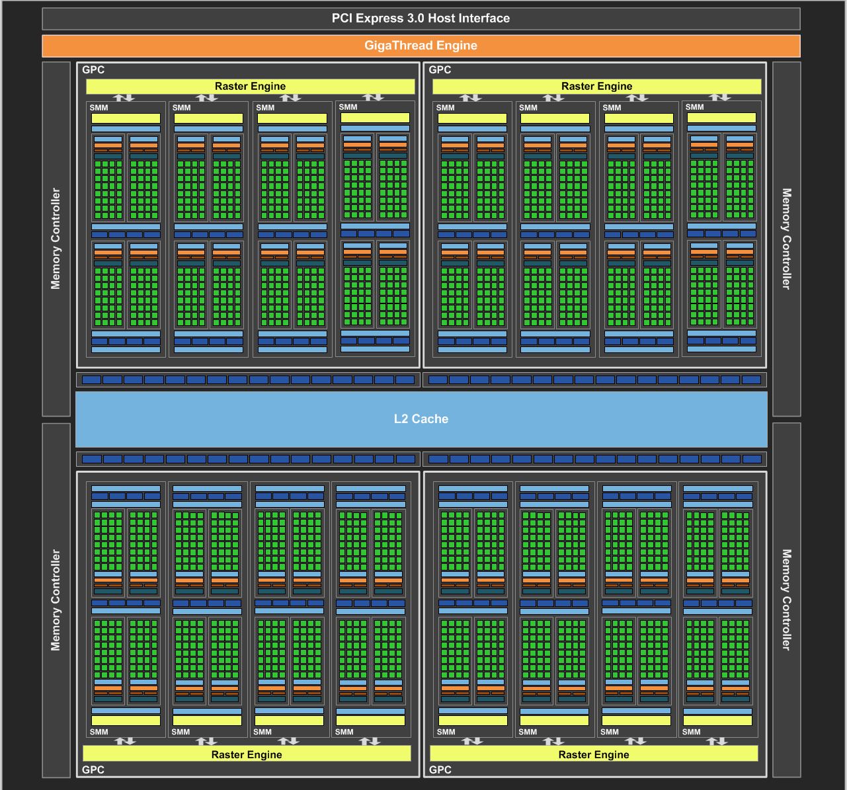
multi-core GPU
current schematic Nvidia
Maxwell
architecture

Slide 21
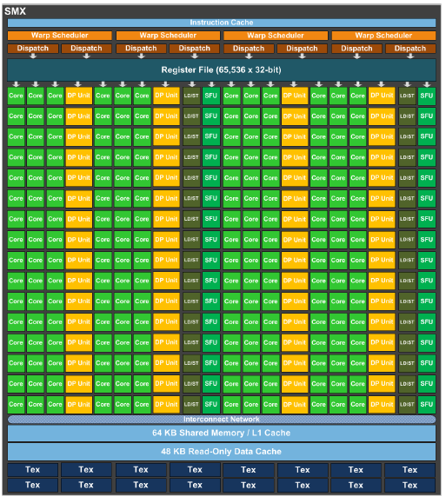
Streaming Multiprocessors (SM,SMX)
single-instruction, multiple-data (SIMD) hardware
32 threads form a warp
Each thread within a warp must execute the same instruction (or be deactivated)
1 instruction → 32 values computed
handle more warps than cores to hide latency

Slide 22
Differences CPU-GPU
Threading resources
  Host currently ~32 concurrent threads
  Device: smallest executable unit of parallelism: “Warp”: 32 thread
  768-1024 active threads per multiprocessor
  Device with 30 multiprocessors: > 30.000 active threads
  Devices can hold billions of threads
Threads
  Host: heavyweight entities, context switch expensive
  Device: lightweight threads
  If the GPU processor must wait for one warp of threads, it simply begins executing work on another Warp.
Memory
  Host: equally accessible to all code
  Device: divided virtually and physically into different types
Notes:
Compare with Imperial supercomputing infrastructure

Slide 23
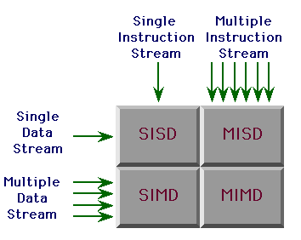
Flynn‘s Taxonomy
SISD: single-instruction, single-data
(single core CPU)
MIMD: multiple-instruction, multiple-data
(multi core CPU)
SIMD: single-instruction, multiple-data
(data-based parallelism)
MISD: multiple-instruction, single-data
(fault-tolerant computers)

Slide 24
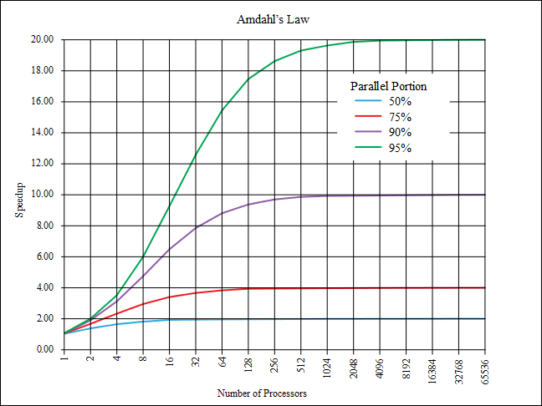
Amdahl‘s Law
- Sequential vs. parallel
- Performance benefit
- P: parallelizable part of code
- N: # of processors

Slide 25
SM Warp Scheduling
SM hardware implements zero overhead Warp scheduling
  Warps whose next instruction has its operands ready for
  consumption are eligible for execution
  Eligible Warps are selected for execution on a prioritized
  scheduling policy
  All threads in a Warp execute the same instruction when
  selected
Currently: ready-queue and memory access score-boarding
Thread and warp scheduling are active topics of research!

Slide 26
Programming GPUs

Slide 27
Programming languages
OpenCL (Open Computing Language):
OpenCL is an open, royalty-free, standard for cross-platform, parallel programming of modern processors
An Apple initiative approved by Intel, Nvidia, AMD, etc.
Specified by the Khronos group (same as OpenGL)
It intends to unify the access to heterogeneous hardware accelerators
  CPUs (Intel i7, …)
  GPUs (Nvidia GTX & Tesla, AMD/ATI 58xx, …)
What’s the difference to other languages?
  Portability over Nvidia, ATI, S3… platforms + CPUs
  Slow or no implementation of new/special hardware features

Slide 28
Programming languages
CUDA:
“Compute Unified Device Architecture”
  Nvidia GPUs only!
  Open source announcement
  Does not provide CPU fallback
  NVIDIA CUDA Forums – 26,893 topics
    AMD OpenCL Forums – 4,038 topics
  Stackoverflow CUDA Tag – 1,709 tags
    Stackoverflow OpenCL Tag – 564 tags
  Raw math libraries in NVIDIA CUDA
    CUBLAS, CUFFT, CULA, Magma
new hardware features immediately available!

Slide 29
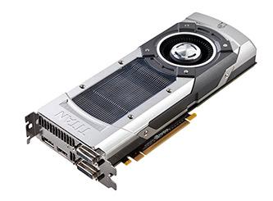
Installation
Download and install the newest driver for your GPU!
OpenCL: get SDK from Nvidia or AMD
CUDA: https://developer.nvidia.com/cuda-downloads
CUDA nvcc complier -> easy access via CMake and .cu files
OpenCL -> no special compiler,
runtime evaluation
Integrated Intel something
graphics -> No No No!

Slide 30
Writing parallel code
Current GPUs have > 3000 cores (GTX TITAN, Tesla K80 etc.)
Need more threads than cores (warp scheduler)
Writing different code for 10000 threads / 300 warps?
→Single-program, multiple-data (SPMD = SIMDI) model
  Write one program that is executed by all threads

Slide 31
CUDA C
CUDA C is C (C++) with additional keywords to control parallel execution
Type qualifiers
Keywords
Intrinsics
__device__ float x;
__global__ void func(int* mem)
{
__shared__ int y[32];
…
y[threadIdx.x] = blockIdx.x;
__syncthreads();
}
…
cudaMalloc(&d_mem, bytes);
func<<<10,10>>>(d_mem);
__global__
__shared__
GPU code
(device code)
__constant__
__device__
threadIdx
__syncthreads()
blockIdx
__any()
Runtime API
GPU function
launches
cudaSetDevice
cudaMalloc
CPU code
(host code)

Slide 32
Kernel
A function that is executed on the GPU
Each started thread is executing the same function
Indicated by __global__
must have return value void
__global__ void myfunction(float *input, float* output)
{
*output = *input;
}

Slide 33

Parallel Kernel
Kernel is split up in blocks of threads

Slide 34
Launching a kernel
A function that is executed on the GPU
Each started thread is executing the same function
Indicated by __global__
must have return value void
dim3 blockSize(32,32,1);
dim3 gridSize((iSpaceX + blockSize.x - 1)/blockSize.x,
(iSpaceY + blockSize.y - 1)/blockSize.y), 1)
myfunction<<<gridSize, blockSize>>>(input, output);
Notes:
Angle brackets

Slide 35
Distinguishing between threads
using threadIdx and blockIdx execution paths are chosen
with blockDim and gridDim number of threads can be determined
__global__ void myfunction(float *input, float* output)
{
uint bid = blockIdx.x + blockIdx.y * gridDim.x;
uint tid = bId * (blockDim.x * blockDim.y) +
(threadIdx.y * blockDim.x) + threadIdx.x;
output[tid] = input[tid];
}

Slide 36
Distinguishing between threads
blockId and threadId
0,0
1,0
0,0
1,0
2,0
3,0
4,0
5,0
6,0
7,0
0,0
1,0
2,0
3,0
4,0
5,0
6,0
7,0
0,0
1,0
2,0
3,0
0,0
1,0
2,0
3,0
0,0
1,0
2,0
3,0
0,0
1,0
2,0
3,0
0,0
1,0
2,0
3,0
1,0
4,0
5,0
6,0
7,0
0,0
0,0
1,0
0,0
1,0
0,0
1,0
3,0
0,0
1,0
0,0
1,0
0,0
1,0
2,0
0,0
1,0
0,0
1,0
0,1
1,1
0,0
1,0
2,0
3,0
4,0
5,0
6,0
7,0
0,0
1,0
2,0
3,0
4,0
5,0
6,0
7,0
0,1
1,1
2,1
3,1
0,1
1,1
2,1
3,1
0,1
1,1
2,1
3,1
0,1
1,1
2,1
3,1
0,1
1,1
0,1
1,1
0,1
1,1
0,1
1,1
0,1
1,1
0,1
1,1
0,1
1,1
0,1
1,1
0,2
1,2
0,0
1,0
2,0
3,0
4,0
5,0
6,0
7,0
0,0
1,0
2,0
3,0
4,0
5,0
6,0
7,0
0,2
1,2
2,2
3,2
0,2
1,2
2,2
3,2
0,2
1,2
2,2
3,2
0,2
1,2
2,2
3,2
0,1
1,1
2,1
3,1
4,1
5,1
6,1
7,1
0,0
1,0
0,0
1,0
0,0
1,0
0,0
1,0
0,0
1,0
0,0
1,0
0,0
1,0
0,0
1,0
0,3
1,3
2,3
3,3
0,3
1,3
2,3
3,3
1,3
0,0
1,0
2,0
3,0
4,0
5,0
6,0
7,0
0,3
1,3
2,3
3,3
0,0
1,0
2,0
3,0
4,0
5,0
6,0
7,0
0,3
0,1
1,1
0,3
1,3
2,3
3,3
0,1
1,1
0,1
1,1
0,1
1,1
0,1
1,1
0,1
1,1
0,1
1,1
0,1
1,1
0,0
1,0
2,0
3,0
4,0
5,0
6,0
7,0
0,0
1,0
2,0
3,0
4,0
5,0
6,0
7,0
0,0
1,0
2,0
3,0
0,4
1,4
0,0
1,0
2,0
3,0
0,0
1,0
2,0
3,0
0,0
1,0
2,0
3,0
0,2
1,2
2,2
3,2
6,2
7,2
1,1
4,2
5,2
0,0
1,0
0,1
2,1
3,1
0,0
1,0
0,0
1,0
0,0
1,0
0,0
1,0
0,0
1,0
0,0
1,0
0,0
1,0
0,5
1,5
0,0
1,0
2,0
3,0
0,1
1,1
2,1
3,1
0,1
1,1
2,1
3,1
4,0
5,0
6,0
7,0
0,0
1,0
2,0
3,0
4,0
5,0
6,0
7,0
0,1
1,1
2,1
3,1
0,1
1,1
2,1
3,1
0,1
1,1
0,1
1,1
0,1
1,1
0,1
1,1
0,1
1,1
0,1
1,1
0,1
1,1
0,1
1,1
0,2
1,2
2,2
3,2
0,2
1,2
2,2
3,2
0,2
1,2
2,2
3,2
0,2
1,2
2,2
3,2
0,6
1,6
0,0
1,0
1,3
2,3
3,3
0,3
2,0
3,0
4,0
5,0
6,0
7,0
0,0
1,0
2,0
3,0
4,0
5,0
6,0
7,0
4,3
5,3
6,3
7,3
0,0
1,0
0,0
1,0
0,0
1,0
0,0
1,0
0,0
1,0
0,0
1,0
0,0
1,0
0,0
1,0
0,3
1,3
2,3
3,3
0,3
1,3
2,3
3,3
0,3
1,3
2,3
3,3
0,3
1,3
2,3
3,3
0,0
1,0
2,0
3,0
4,0
5,0
6,0
7,0
0,0
1,0
2,0
3,0
4,0
5,0
6,0
7,0
0,7
1,7
0,1
1,1
0,1
1,1
0,1
1,1
0,1
1,1
0,1
1,1
0,1
1,1
0,1
1,1
0,1
1,1
0,0
1,0
2,0
3,0
0,0
1,0
2,0
3,0
0,0
1,0
2,0
3,0
0,4
5,4
6,4
7,4
0,0
1,0
1,4
2,4
3,4
4,4
0,0
1,0
2,0
3,0
2,0
3,0
4,0
5,0
6,0
7,0
0,0
1,0
2,0
3,0
4,0
5,0
6,0
7,0
0,8
1,8
0,2
1,2
2,2
3,2
0,0
1,0
0,0
1,0
0,0
1,0
0,0
1,0
0,0
1,0
0,0
1,0
0,0
1,0
0,0
1,0
0,1
1,1
2,1
3,1
0,1
1,1
2,1
3,1
0,1
1,1
2,1
3,1
0,1
1,1
2,1
3,1
0,9
1,9
0,0
1,0
2,0
3,0
4,0
5,0
6,0
7,0
0,0
1,0
2,0
3,0
4,0
5,0
6,0
7,0
0,1
1,1
0,1
1,1
0,1
1,1
0,1
1,1
0,1
1,1
0,1
1,1
0,1
1,1
0,1
1,1
0,2
1,2
2,2
3,2
0,2
1,2
2,2
3,2
0,2
1,2
2,2
3,2
0,2
1,2
2,2
3,2
0,5
1,5
2,5
3,5
0,10
1,10
4,5
5,5
6,5
7,5
0,0
1,0
2,0
3,0
0,0
1,0
0,0
1,0
0,0
1,0
0,0
1,0
0,0
1,0
0,0
1,0
4,0
5,0
6,0
7,0
0,0
1,0
2,0
3,0
4,0
5,0
6,0
7,0
0,0
1,0
0,0
1,0
0,3
1,3
2,3
3,3
0,3
1,3
2,3
3,3
0,3
1,3
2,3
3,3
0,3
1,3
2,3
3,3
0,0
1,0
2,0
3,0
0,1
1,1
0,1
1,1
0,1
1,1
0,1
1,1
0,1
1,1
0,1
1,1
4,0
5,0
6,0
7,0
0,0
1,0
2,0
3,0
4,0
5,0
6,0
7,0
0,1
1,1
0,1
1,1
0,11
1,11

Slide 37
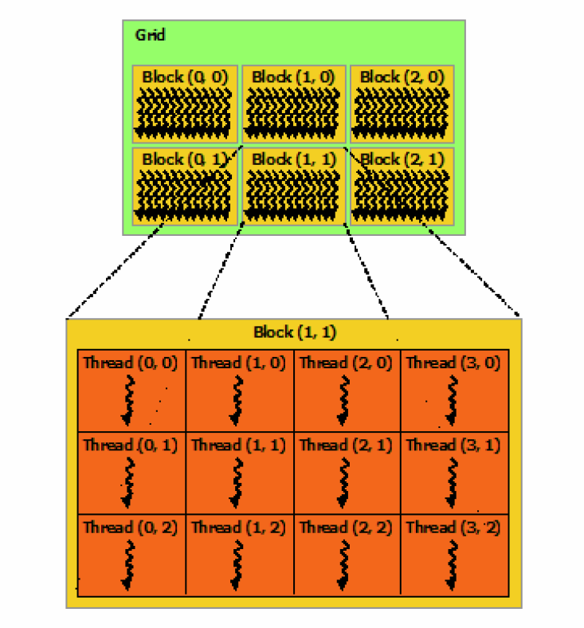
Grids, Blocks, Threads

Slide 38
Blocks
Threads within one block…
  are executed together
  can be synchronized
  can communicate efficiently
  share the same local cache
  → can work on a goal cooperatively

Slide 39
Blocks
Threads of different blocks…
  may be executed one after another
  cannot synchronize on each other
  can only communicate inefficiently
  → should work independently of other blocks

Slide 40
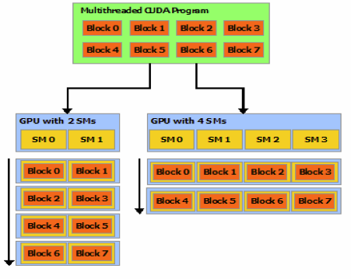
Block Scheduling
Block queue feeds multiprocessors
Number of available multiprocessors determines number of concurrently executed blocks

Slide 41
Blocks to warps
On each multiprocessor each block is split up in warps Threads with the lowest id map to the first warp
0,0
1,0
2,0
3,0
4,0
5,0
6,0
7,0
8,0
9,0
10,0
11,0
12,0
13,0
14,0
15,0
warp 0
0,1
1,1
2,1
3,1
4,1
5,1
6,1
7,1
8,1
9,1
10,1
11,1
12,1
13,1
14,1
15,1
0,2
warp 1
1,2
2,2
3,2
4,2
5,2
6,2
7,2
8,2
9,2
10,2
11,2
12,2
13,2
14,2
15,2
0,3
1,3
2,3
3,3
4,3
5,3
6,3
7,3
8,3
9,3
10,3
11,3
12,3
13,3
14,3
15,3
0,4
1,4
2,4
3,4
4,4
5,4
6,4
7,4
8,4
9,4
10,4
11,4
12,4
13,4
14,4
15,4
warp 2
0,5
1,5
2,5
3,5
4,5
5,5
6,5
7,5
8,5
9,5
10,5
11,5
12,5
13,5
14,5
15,5
0,6
1,6
2,6
3,6
4,6
5,6
6,6
7,6
8,6
9,6
10,6
11,6
12,6
13,6
14,6
15,6
warp 3
0,7
1,7
2,7
3,7
4,7
5,7
6,7
7,7
8,7
9,7
10,7
11,7
12,7
13,7
14,7
15,7

Slide 42
Where to start
CUDA programming guide: https://docs.nvidia.com/cuda/cuda-c-programming-guide/
OpenCL http://www.nvidia.com/content/cudazone/download/opencl/nvidia_opencl_programmingguide.pdf
http://developer.amd.com/tools-and-sdks/opencl-zone/

Slide 43
GPU programming
Dr. Bernhard Kainz

